Slide 1
NLP

Slide 2
Introduction to NLP
Sentiment Lexicons

Slide 3
Sentiment Lexicons
SentiWordNet
http://sentiwordnet.isti.cnr.it/
General Inquirer
2,000 positive words and 2,000 negative words
http://www.wjh.harvard.edu/~inquirer/
LIWC
http://liwc.wpengine.com/
Bing Liu’s opinion dataset
http://www.cs.uic.edu/~liub/FBS/opinion-lexicon-English.rar
MPQA subjectivity lexicon
http://mpqa.cs.pitt.edu/lexicons/subj_lexicon/

Slide 4
General Inquirer
Annotations
Strong Power Weak Submit Active Passive Pleasur Pain Feel Arousal EMOT Virtue Vice Ovrst Undrst Academ Doctrin Econ@ Exch ECON Exprsv Legal Milit Polit@ POLIT Relig Role COLL Work Ritual SocRel Race Kin@ MALE Female Nonadlt HU ANI PLACE Social Region Route Aquatic Land Sky Object Tool Food Vehicle BldgPt ComnObj NatObj BodyPt ComForm COM Say Need Goal Try Means Persist Complet Fail NatrPro Begin Vary Increas Decreas Finish Stay Rise Exert Fetch Travel Fall Think Know Causal Ought Perceiv Compare Eval@ EVAL Solve Abs@ ABS Quality Quan NUMB ORD CARD FREQ DIST Time@ TIME Space POS DIM Rel COLOR Self Our You Name Yes No Negate Intrj IAV DAV SV IPadj IndAdj PowGain PowLoss PowEnds PowAren PowCon PowCoop PowAuPt PowPt PowDoct PowAuth PowOth PowTot RcEthic RcRelig RcGain RcLoss RcEnds RcTot RspGain RspLoss RspOth RspTot AffGain AffLoss AffPt AffOth AffTot WltPt WltTran WltOth WltTot WlbGain WlbLoss WlbPhys WlbPsyc WlbPt WlbTot EnlGain EnlLoss EnlEnds EnlPt EnlOth EnlTot SklAsth SklPt SklOth SklTot TrnGain TrnLoss TranLw MeansLw EndsLw ArenaLw PtLw Nation Anomie NegAff PosAff SureLw If NotLw TimeSpc
http://www.webuse.umd.edu:9090/tags
Positive: able, accolade, accuracy, adept, adequate…
Negative: addiction, adversity, adultery, affliction, aggressive…

Slide 5
Dictionary-based Methods
Start from known seeds
e.g., happy, angry
Expand using WordNet
synonyms
hypernyms
Random-walk based methods
words with known polarity as absorbing boundary

Slide 6
Automatic Extraction of Sentiment Words
Semi-supervised method
Look for pairs of adjectives that appear together in a conjunction
Vasileios Hatzivassiloglou and Kathleen R. McKeown, ACL 1997

Slide 7
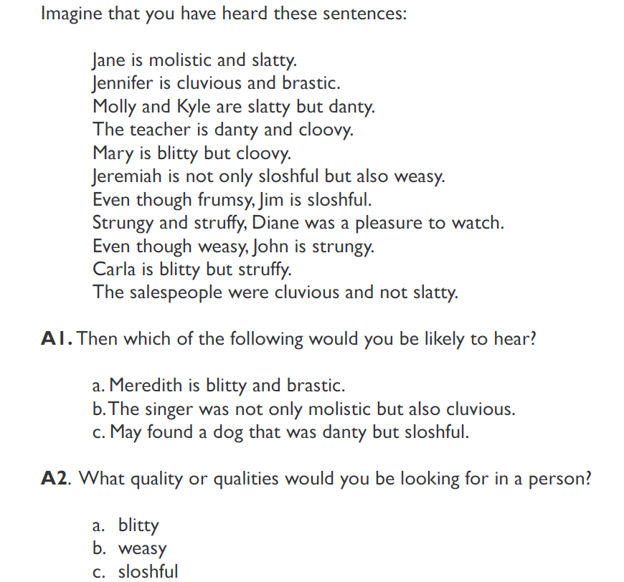
Molistic
NACLO problem (2007)

Slide 8
brastic
2
cluvious
11
molistic
3
danty
1
slatty
4
cloovy
5
blitty
10
struffy
weasy
8
9
strungy
6
sloshful
8
pleasure to watch
7
frumsy
Notes:
Solid line for “and”, dashed line for “but”.
Bipartite graph.

Slide 9
PMI (Turney)
PMI = pointwise mutual information
Check how often a given unlabeled word appears with a known positive word (“excellent”)
Same for a known negative word (“poor”)

Slide 10
Datasets
http://www.cs.cornell.edu/people/pabo/movie-review-data/
http://www.cs.jhu.edu/~mdredze/datasets/sentiment/
http://help.sentiment140.com/other-resources
https://blog.cambridgespark.com/50-free-machine-learning-datasets-sentiment-analysis-b9388f79c124

Slide 11
NLP

